Slide 1

Shield U.S.
TARGET, TEST, TELL
A COVID-19 testing system to get the U.S. back up and running more safely as we bridge to widespread vaccination

Slide 2
Even with the imminent distribution of vaccines we will need extensive testing to control TRANSMISSION of SARS-CoV-2 throughout 2021
shield | target, test, tell
Deploying the vaccines will take time
Many people do not want to be vaccinated
While the vaccines appear highly effective, there is still risk
New strains of the virus are emerging
Superspreader events can still cause hotspots

Slide 3

Shield programs
shield | target, test, tell
We test more rapidly, frequently, broadly, and accurately.
We tell – giving individuals and organizations the ability to react quickly.
We target – providing the intelligence needed to be proactive.

Slide 4
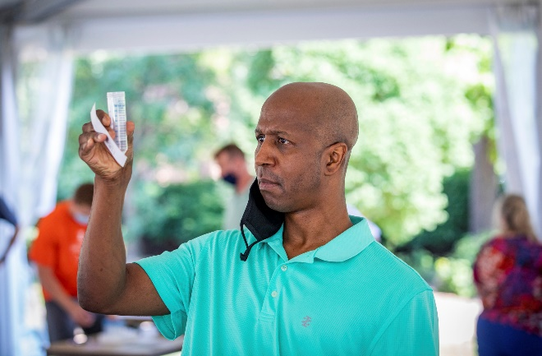
shield works — we have >1,000,000 testS to prove it
shield | target, test, tell
The SHIELD system at University of Illinois Urbana-Champaign (UIUC) has demonstrated that it can:
Control an epidemic
Support in-person university classes and get students back to school
All with zero:
Hospitalizations or deaths
Transmission to the local community
Transmission within classrooms

Slide 5
the UIUC program shield university
shield | target, test, tell

Slide 6
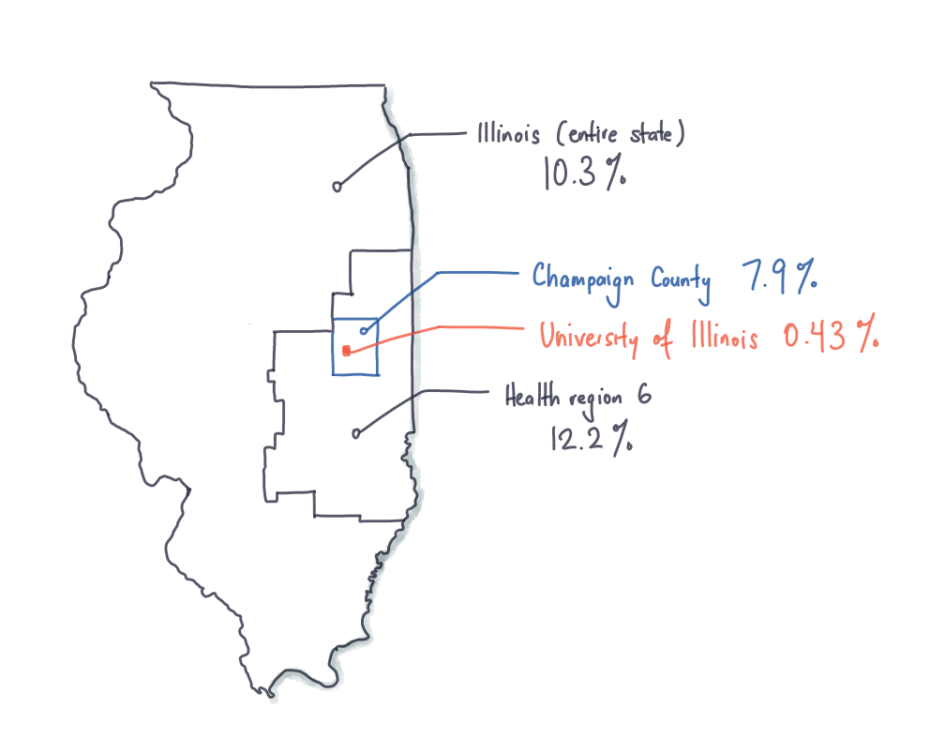
With shield in place, uiuc is the safest place in the state and probably in the country
shield | target, test, tell
Repeated testing of population reduces transmission
Modeling & our experience shows that frequent screening every 2-3 days of entire population will control outbreaks
Success relies on commitment to frequent screening, and multi-layered behavioral interventions such as universal masking
Region 6 positivity much higher than our surrounding county
Declining positivity rates in state still 25 times greater than at UIUC
Notes:
Repeated testing of population reduces transmission
Modeling & our experience shows that frequent screening every 2-3 days of entire population will control outbreaks
Success relies on commitment to frequent screening, and multi-layered behavioral interventions such as universal masking
Region 6 positivity much higher than our surrounding county!
Declining positivity rates in state still 25 times greater than at University of Illinois –Urbana /Champaign

Slide 7
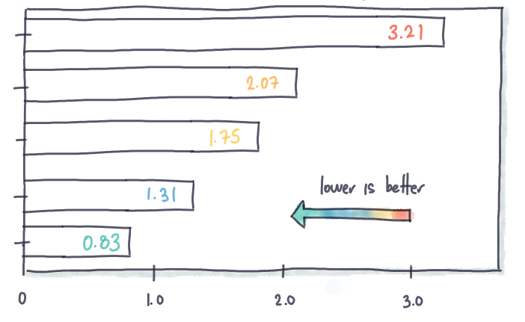
The most effective mitigation strategies include large scale testing and more
shield | target, test, tell
Transmissivity of Covid-19 as a Function of Different Mitigation Strategies
Evidence has shown that a multitude of strategies can work to control outbreaks
Testing everyone twice a week is one of the most effective strategies
Testing alone is not enough
It takes a multi-faceted approach
No mitigation
Mask
Two tests / week
Large classes online
Two tests / week plus mask
R_{o} — Transmissivity

Slide 8
WHEN WE DEPLOYED Shield, IT PROVED to be EFFECTIVE AT containing outbreaks – PLAYING OFFENSE INSTEAD OF DEFENSE
shield | target, test, tell
University observes some lack of student compliance
Second smaller increase; data showed cases distributed evenly across students, faculty and staff, and correlated with rising cases in Champaign County. This data enabled a different response with increase testing frequency for faculty and staff that contained outbreak again.
Real time data enables university to prioritize student testing and initiate “SHIELD Team 30” to isolate students that test positive even faster (30 min)
Students arrive on campus
250
3
200
2.5
Daily new cases
2
150
Daily case positivity rate
100
1.5
50
1
0.5
July
Aug
Sept
Oct
Nov
Dec
We run over 10,000 tests per day on campus
We test at scale – every undergraduate student twice a week
We turn around tests in under 12 hours
We contact trace rapidly – isolate in under 3 hours

Slide 9
Shield delivers on six KEY aspects needed for a successful ecosystem
shield | target, test, tell
Speed
Less than 12 hours from sample collection to results
Rapid contact tracing
Accuracy
A PCR test that is 99.8% accurate & very few false positives
Scale
Every UIUC student is tested 2x a week
Up to 17,000 tests a day
Collection
Saliva based, far more comfortable so you can do more frequent testing
Cost
Cost is less than $10/test, compared to $30-35 for other saliva-based tests and $45 for an NP swab
Access
Dedicated local testing so local communities can have fast, accurate, and best cost testing

Slide 10
SHIELD’S TEST is more Accurate WITH THE CONVENIENCE OF A SALIVA SAMPLE
shield t3 | target, test, tell
Illinois Saliva
Saliva provides a more relevant indication of infectiousness than nasal swabs
Our saliva test has very high specificity, reducing the cost and disruption of false positives and the quarantine and isolation that result
Shield’s test has a lower limit of detection (LoD) than other saliva tests – 8 times lower than Yale’s SalivaDirect
We have validated the LoD at 1.5 viral copies per microliter
Notre Dame, U. of Wisconsin, U. of Oregon, Carnegie Mellon, and many others are using/planning to use the UIUC saliva test
SHIELD protocol 8X more sensitive
SalivaDirect

Slide 11
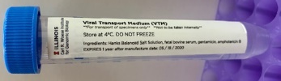
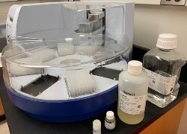

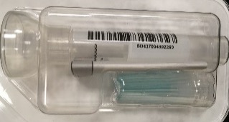
Shield delivers the best cost and removes supply chain bottlenecks
shield | target, test, tell
Standard method:
$40 to 45 per test
NP swab
Viral Transport Medium
RT-qPCR
RNA purification kit
$30 to 35 per test
Saliva (FDA EUA approval April 2020):
Saliva collection
RNA purification kit
RT-qPCR
Less than $10 per test*
UIUC Saliva developed by Paul Hergenrother:
Saliva collection
RT-qPCR
* Costs are based on consumable costs, lab costs, equipment costs, labor costs but does not include any costs above the lab such as administration, sourcing, financing, etc. Does not include specimen collection costs, which are higher for swabs than saliva. The costs assume a high volume. If the lab operates at volumes below 2,000 test per day these cost are higher.

Slide 12

The test is just the beginning of the process — Fast notification and isolation ARE essential
shield | target, test, tell
At UIUC we are able to perform contact tracing and isolation within 3 hours of test result
For notifications SHIELD uses the Safer Illinois app
  Supports contact tracing
  Protects privacy
  Seamlessly shares results with participants, university and local public health is required
Our reporting programs are flexible and can work with other common systems like Epic’s MyChart or PointNClick.

Slide 13

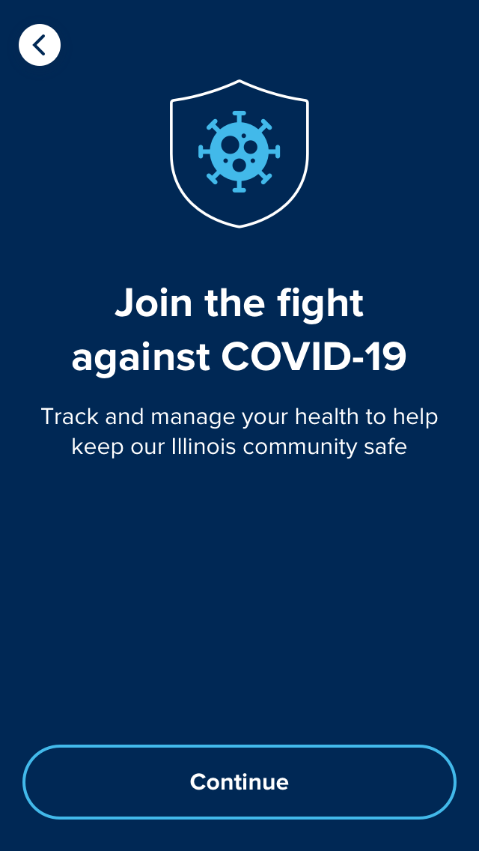
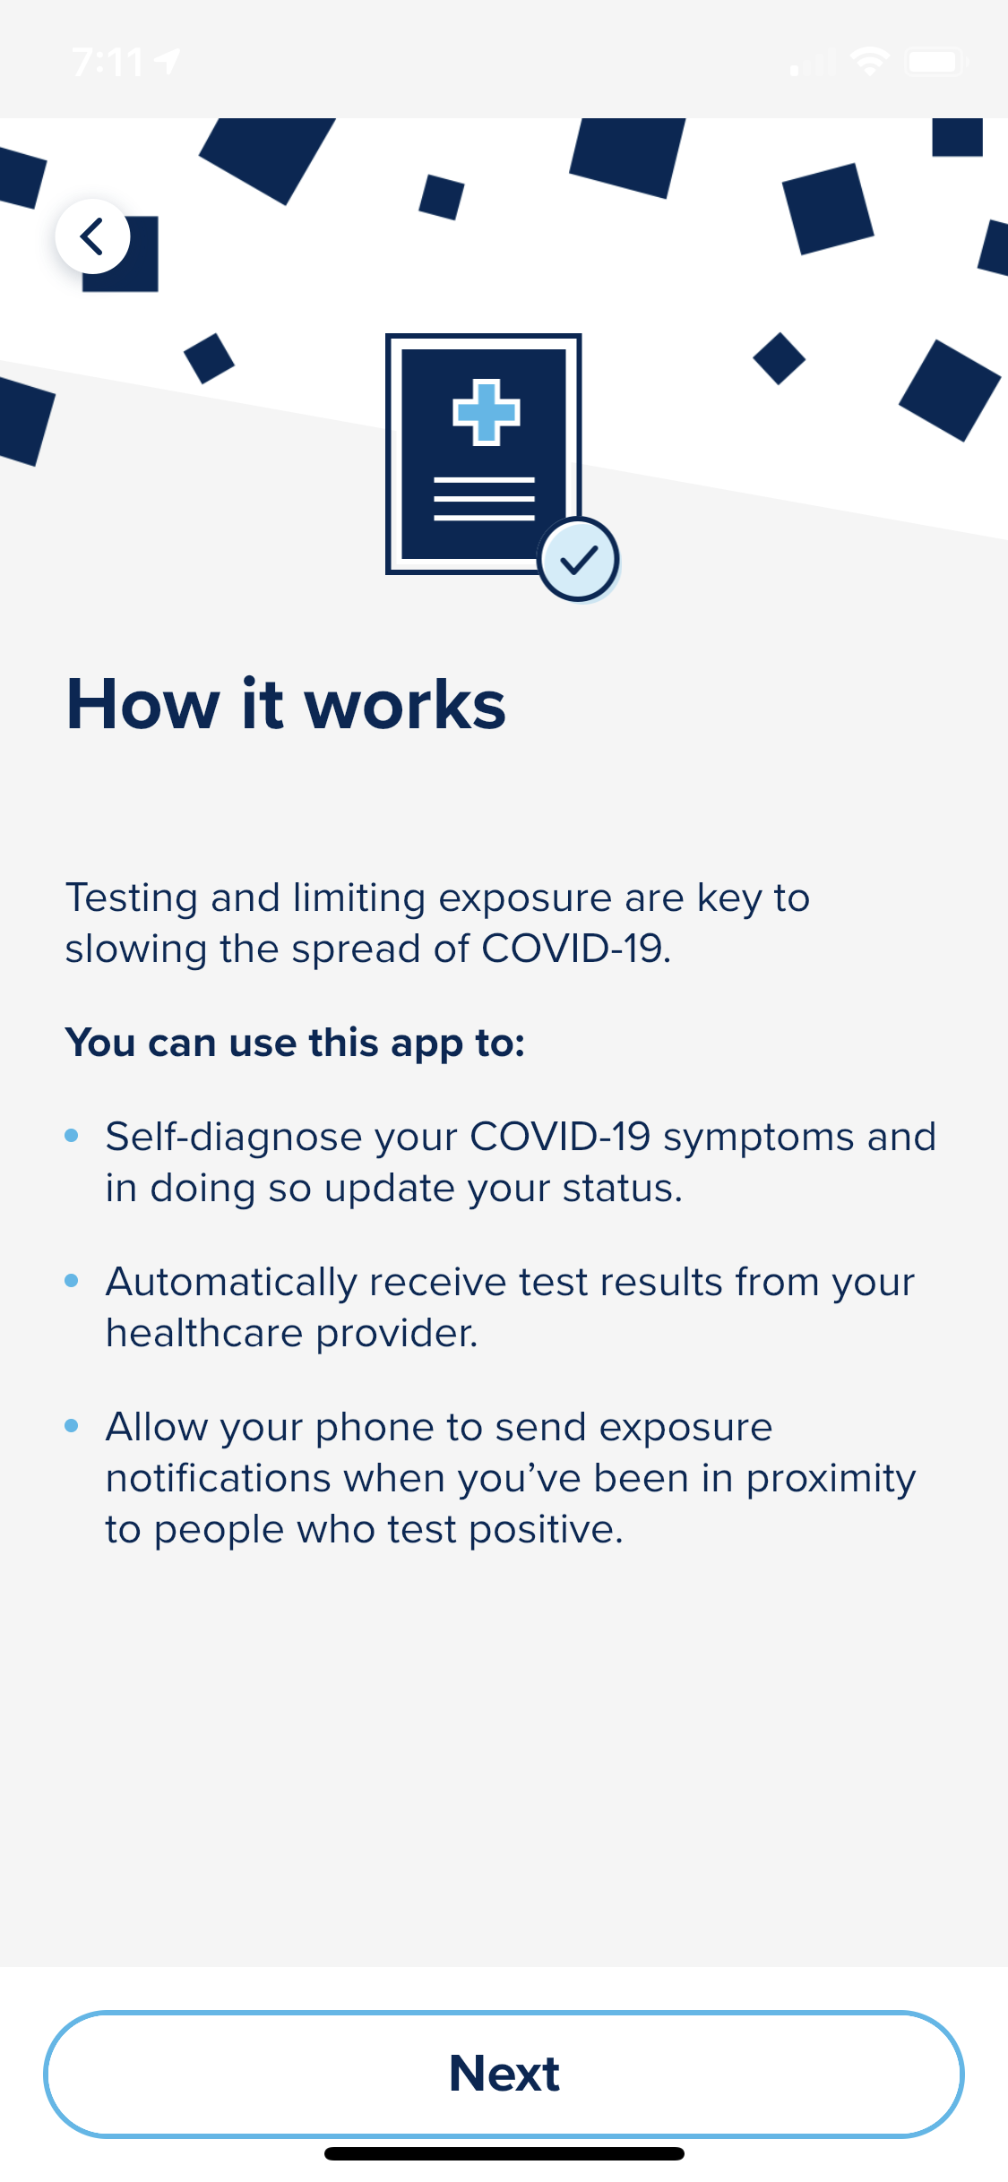



Slide 14
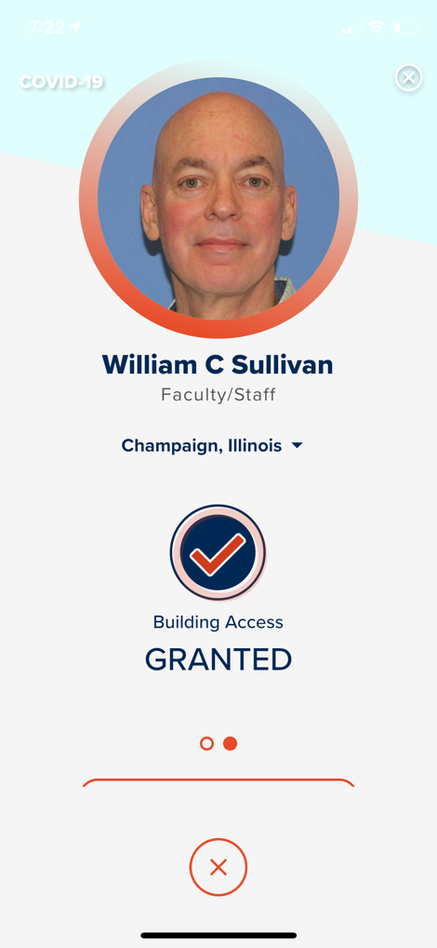
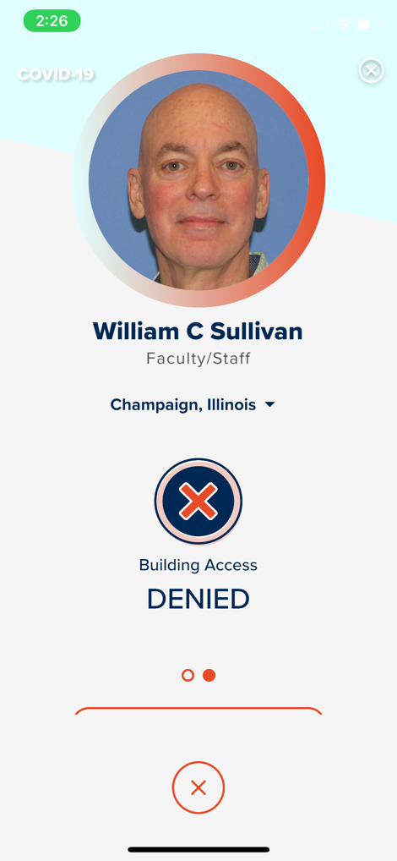
The app is central to our “Do to Do” model
The “Privacy First” feature that allows the user to manage privacy is critical.
The application helps with behaviors by requiring compliance for access – Do-To-Do Model.
A “do-to-do” expectation requires one to “do” what is expected in order to be able to “do” what one intends.
The University requires a safe status for access to university buildings, based on recent test results, health check status and proximity tracing.
We have over 45,000 people actively using the application.
The community has embraced the application demanding a safe status for admittance to their business.
The App has been surprisingly popular at the University and is now in broad civic use in the broader community (e.g., grocery stores, etc.).

Slide 15
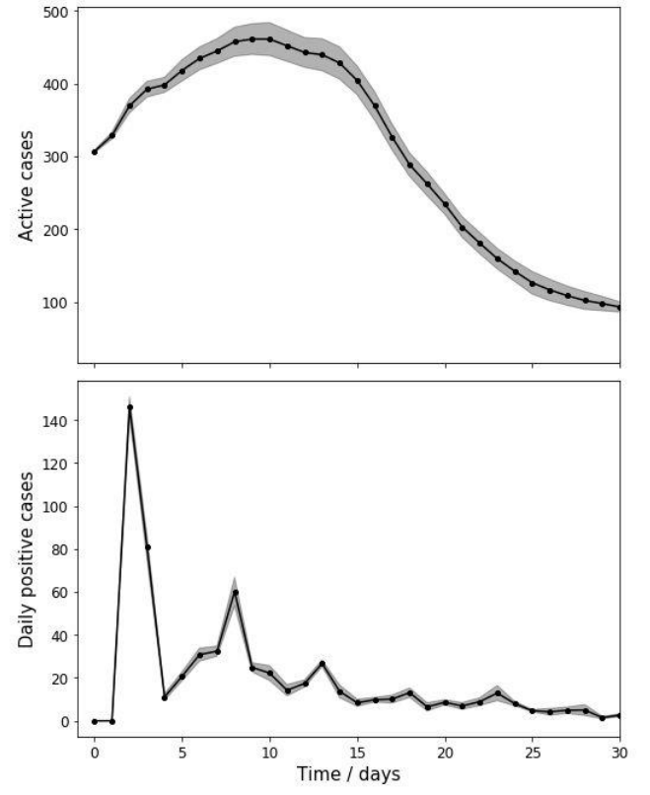
The SHIELD team monitors and adjusts to deal with inevitable issues
shield | target, test, tell
Decay of a virus spike is
around a month
A team of university researchers is devoted to analyzing data and adapting the strategy
  Change testing frequency for certain cohorts
  Change policies like increased distancing
  Expand health education efforts
  Discipline
  Better aligns incentives
The team’s success is driven by their deep expertise with the virus and infectious disease modeling
Notes:
A small team at Illinois tracks and understand the implications
The team quickly adjusts, locally
Change testing frequencies for certain cohorts
Change policies – increase distancing
Increase education
Discipline
Align incentives
There must be a deep understanding of the virus
Example calculation with 24 hour test turnaround
Time scale of decay of spike is > 4 weeks
Non-compliance and test processing time have similar outcome
Illustrative of 12 hour test turnaround and partial compliance by extremely socially active students

Slide 16
Expanding our impact — shield Illinois and shield t3
shield | target, test, tell

Slide 17

Shield Illinois — supporting the state to deploy a testing network
shield | target, test, tell
After our successful UIUC pilot, we are deploying labs to state-wide testing locations to reduce the overall rate of infection statewide
Labs are located near high-population areas to increase access
Locations are selected based on logistical factors like ease of transportation
This is a public + private partnership leveraging public university facilities to stand up labs
Labs must be CLIA certified and able to process tests at anticipated capacity

Slide 18
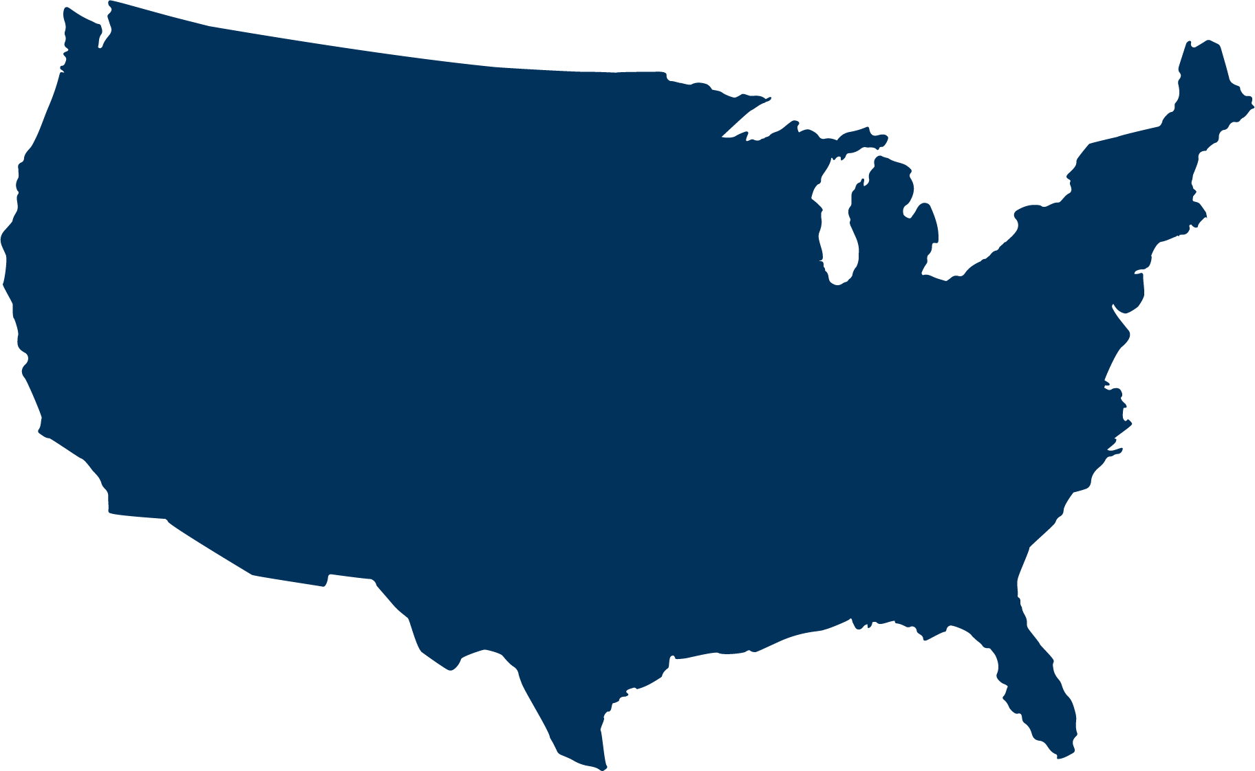




Shield T3 — deploying a testing network across the us and abroad
shield | target, test, tell
Mobile Labs
Services
Trailers with fully equipped labs
10,000 test/day capacity
Operated and staffed by SHIELD T3
Samples collected by the customer
Consult with customer owned and operated labs (mostly other universities and foreign entities)
Share set-up and operational knowledge to run the SHIELD T3 test

Slide 19
Based upon our experience, here is what we recommend
shield | target, test, tell

Slide 20
Shield U.S. — A hyperlocal national strategy for thriving safely as we bridge to widespread vaccination
shield | target, test, tell
Empower local communities across the U.S. to set up SHIELD testing system, with four tiers:
  25 largest US cities — build testing hubs with 100,000 tests per day capacity
  50 next largest US cities — build mobile labs with 10,000 tests per day capacity
  All major universities — build labs with 10,000 tests per day capacity
  Help local communities incorporate variants of SHIELD into a customized strategy for reopening primary education by providing a K-12 playbook and associated resources

Slide 21
Shield U.S. — ESTIMATED COSTS and Timelines
shield | target, test, tell
Costs to build out the labs:
Labs in 25 cities at 100,000 per city will cost around $250 million (or $10 million per city)
50 Trailers will cost $50 million ($1 million per trailer)
Organizational costs:
City needs around 20 people above the labs -- $2 million per year – or $50 million for 25 cities
We would need probably another $0.3 million per trailer or $15 million for 50 trailers
State and federal costs are not included
Costs to run the tests for 100 days:
Testing costs is $10 per test plus collection costs / transportation costs ($5 per test), so $15 per test
Running 3 million test per day the cost is $45 million per day
Running for 100 days or 4 months – will cost $4.5 billion
Total costs
Labs -- $300 million
Organizational costs -- $65 million per year
Running the test for 4 to 5 months is $4.5 billion
This plan could be stood up and launched over a 5 week timeframe
$20 billion dedicated to testing in new stimulus package

Slide 22
Learnings: Large scale testing is the backbone to opening up more safely and more sustainably
Recommendations
Opening up society as much as possible for economic, educational, entertainment and religious activity depends on local successes in testing, contact tracing, isolation, behaviors and thoughtful policies
Overwhelming the healthcare infrastructure is extremely costly and shuts down the economy
Any serious program must address the fundamentals of the virus
Key learnings from various places teach us important lessons:
  COVID is a “cluster” problem – spreading in clusters
  Extensive testing (highly sensitive) is a critical element of containing the virus, only if the turnaround time of the test is less than 24 hours and the test can detect the virus by day 3 of infection
  Quick action in isolating infected individuals must be effective and rapid
  Electronic contact is required but privacy concerns need to be addressed
  Behavioral boundaries are critical both for personal protection and to limit superspreader events
  The virus must be reacted to locally with strong monitoring and benchmarking and policy shifts locally
What does not work:
  Broad and blanket solutions do not work – it requires local precision responses
  Don’t react to lagging indicators like hospitalizations and deaths – it doesn’t work
  You can’t be effective without community involvement and local partnering
Notes:
Deploy SHIELD nationwide: hyperlocal, scalable, and multimodal approach (fast/frequent testing and isolation in concert with masks, social distancing, and do-to-do model) to reopen and stay open safely
Build sufficient capacity with four levels
Across the largest 25 cities build a testing hub that can do at least 100,000 test per day (each hub will cost $10 million to build out)
Build 50 Mobile Labs that can do 10,000 test per day, locating these labs in the next most populated cities ($1 million per lab)
Build Labs in all major Universities that can do 10,000 test per day ($1 million per lab)
Provide K-12 playbook and associated resources to allow local communities to incorporate variants of SHIELD into a locally customized multimodal strategy for re-opening primary education

Slide 23
We have nine recommendations
Recommendations
Make SHIELD Illinois Saliva test broadly available as the backbone of national testing
Test results that take over 24 hours should not be reimbursed
Add over 3 million daily tests and require turnaround times of under 24 hours for all tests
Redesign the contact tracing system so it is rapid – less than 12 hours – starting with picking an electronic application – we suggest Safer Illinois application
Help, build and train local communities to run and tailor SHIELD to their community
Work hard on behaviors and adopt the ”do to do” model
Actively manage the supply chain constrains. They are real but can be resolved with active management
Build out the organization capacity at three levels – federal, state and local
Use the Federal stimulus funding so Local Health Departments can set up SHIELD programs
Notes:
Deploy SHIELD nationwide: hyperlocal, scalable, and multimodal approach (fast/frequent testing and isolation in concert with masks, social distancing, and do-to-do model) to reopen and stay open safely
Build sufficient capacity with four levels
Across the largest 25 cities build a testing hub that can do at least 100,000 test per day (each hub will cost $10 million to build out)
Build 50 Mobile Labs that can do 10,000 test per day, locating these labs in the next most populated cities ($1 million per lab)
Build Labs in all major Universities that can do 10,000 test per day ($1 million per lab)
Provide K-12 playbook and associated resources to allow local communities to incorporate variants of SHIELD into a locally customized multimodal strategy for re-opening primary education

Slide 24
First Recommendation: Pick a test with low limits of detection
Recommendations
Low limits of detection are key for surveillance testing since we must detect the virus as early as possible after infection
All COVID tests are not equal
The SHIELD saliva test is the best option
        It is a PCR test with inherently low limit of detection (LoD)
        Saliva-based tests have a lower LoD than nasal-based antigen tests
        The SHIELD saliva test has lower LoD than other saliva-based tests
        Sample collection does not have the discomfort of nasopharyngeal sample collection, nor does it require trained medical personnel
Antigen tests should be used where speed is of utmost importance
        Antigen tests have inadequate LoDs for surveillance testing
        They do have a significant speed advantage and should be used for testing immediately prior to events (large meetings, air travel, sporting events, dinner events…)

Slide 25
First Recommendation (CONTINUED) – MAKE SHIELD Illinois Saliva test broadly available as the backbone of testing
Recommendations
SHIELD test is accurate and compares favorably to other saliva-based tests and antigen tests
  SHIELD saliva test has a validated LOD at 1.5 viral copies per microliter
  Yale’s SalivaDirect, for example, is eight times less sensitive than Illinois SHIELD and should not be used
  Antigen tests can only be used for symptomatic patients
In comparison to the other leading saliva-based test, SHIELD’s test has a lower LOD and a demonstrated capability to run at very high volumes, up to nearly 17,500 tests per day in on campus
The SHIELD test has very high specificity, reducing the cost and disruption of false positives and the quarantine and isolation that result. We have run our campus testing system for months and most days the positivity rate was 0.3% to 0.4%, implying that the false positive rate is extremely low.
Antigen tests should only be used in symptomatic testing
  On our sports teams, the antigen test only picking up the virus 1 in 9 times against the saliva test
  Based on this data and on the summary data in the recent articles, antigen testing cannot play any role in controlling the pandemic.

Slide 26
Second Recommendation: Test results that take over 24 hours should not be reimbursed. This action requires and will force more local deployment of testing
Recommendations
Speed is critical
        Average time between infection and symptoms is 5 ½ days
        Average time between infection and transmission to another person is 5 days
        At least half the infectious people don’t know they are
We cannot wait days for test results
        Tests often do not detect the virus the first couple of days after infection
        Most tests are not performed immediately after the virus is detectable
        We cannot afford adding more days before the results are available
Not reimbursing for test results that take over 24 hours provides an incentive for quick turnaround times
        Localized testing capacity (within 3 to 4 hours from sample collection site)
        Quick processing in the lab
        Speedy notification

Slide 27
third Recommendation: Add over 3 million daily tests
Recommendations
High testing capacity is needed to open society
        Need extensive testing regimen across densely populated areas
        Create a testing plan for schools – K-12 – for example, test teachers and administrators at least once a week
        Create a testing plan for the communities at large by providing an extensive network of saliva PCR testing collection sites
        Establish the ability for communities to leverage federal resources to build localized SHIELD ecosystems and test twice a week
        Require same day PCR test results for in-door activities like bars and restaurants
Building sufficient saliva-based PCR capacity across four tiers of
  25 largest US cities — build testing hubs with 100,000 tests per day capacity ($10 million per hub)
  50 next largest US cities — build mobile labs with 10,000 tests per day capacity ($1 million per lab)
  All major universities — build labs with 10,000 tests per day capacity ($1 million per lab)
  Help local communities incorporate variants of SHIELD into a customized strategy for reopening primary education by providing a K-12 playbook and associated resources
  Labs must be local to meet turnaround requirement (within a 3- to 4-hour drive radius)
  Each incremental test will cost less than $10 per test if you use Illinois Shield Saliva test. 3 million test per day will cost less than $30 million per day
Notes:
Deploy SHIELD nationwide: hyperlocal, scalable, and multimodal approach (fast/frequent testing and isolation in concert with masks, social distancing, and do-to-do model) to reopen and stay open safely
Build sufficient capacity with four levels
Across the largest 25 cities build a testing hub that can do at least 100,000 test per day (each hub will cost $10 million to build out)
Build 50 Mobile Labs that can do 10,000 test per day, locating these labs in the next most populated cities ($1 million per lab)
Build Labs in all major Universities that can do 10,000 test per day ($1 million per lab)
Provide K-12 playbook and associated resources to allow local communities to incorporate variants of SHIELD into a locally customized multimodal strategy for re-opening primary education

Slide 28
third Recommendation (Continued): Across large cities add at least 100,000 test per day by building two test lab hubs in each city
National Recommendations
The Broad Institute is an example of a very successful testing HUB – they do over 100,000 test per day, but their turnaround time needs to improve to below 24 hours
Build saliva based (not nasal) testing centers, like the Broad Institute, across all major cities
The top 25 metropolitan areas represent more than 40 plus percent of the population (137 million people)
We need to build testing hubs with a combined capacity of at least 2.5 million tests per day across these cities
Work with the mayors and local health departments to do the following
        Set up at least 10 testing production lines with a production capacity of 10,000 test per day per line, using the SHIELD lab template
        Place these production lines in one to two sites across each city. The sites must be BSL level 2.
        Hire and train 20 lab personnel per product line and lab supervisor (200 people per 100,000 tests per day)
        Set up specimen collection sites across the city -- about 20 to 50 collection sites per city use the MSAs (use the Illinois / Shield T3 SOPs for indoor and outdoor sites)
        For larger cities, we should consider increasing the testing capacity beyond 100,000. For smaller cities, the testing capacity should be used beyond the city boundries.

Slide 29
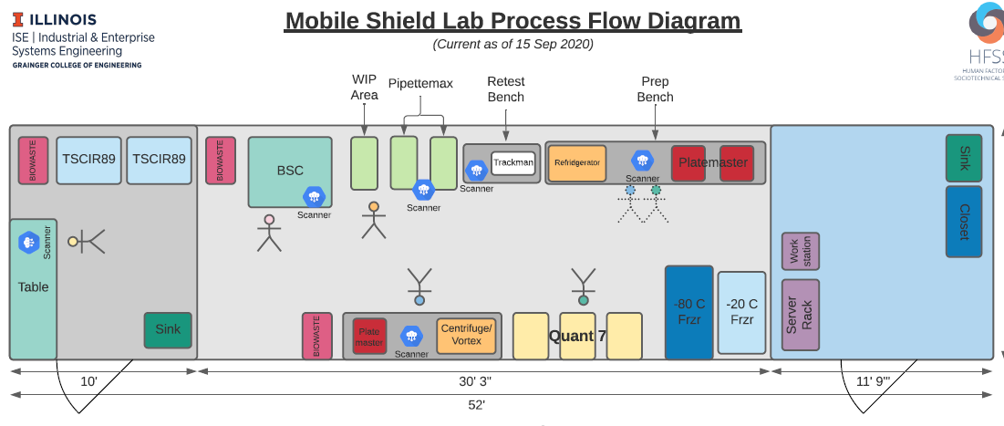
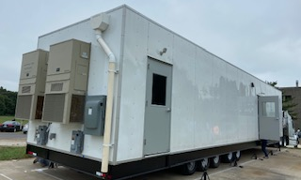
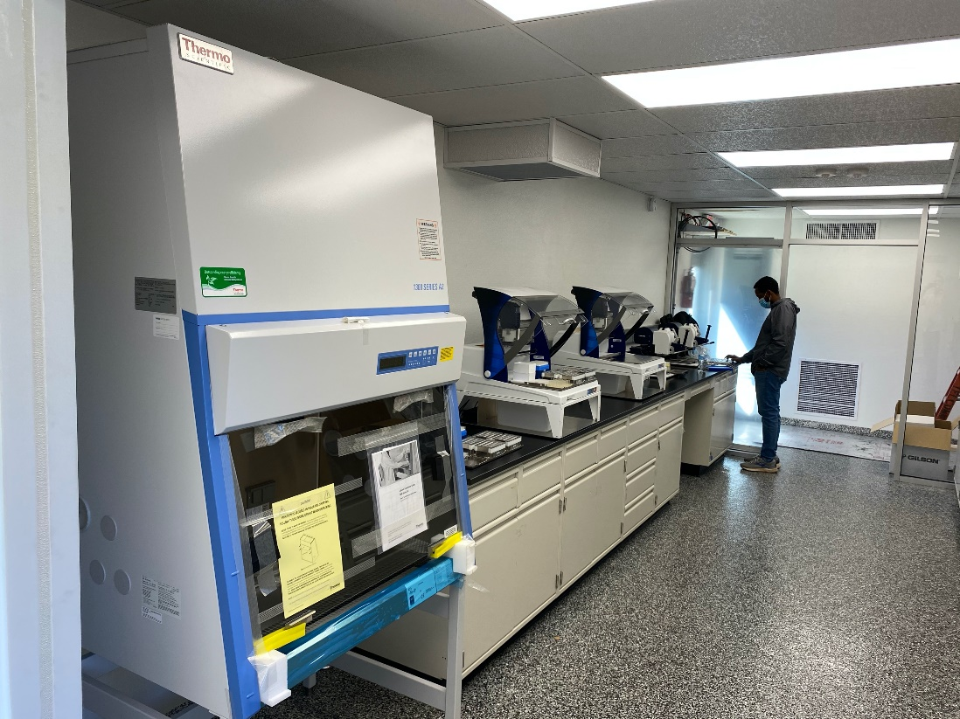
Third Recommendation (Continued): 50 mobile test labs can be quickly built and deploy across other cities and communities within eight to twelve weeks
National Recommendations
We can scale the production of these labs
We outfit a 52 foot trailer or we can outfit a mobile home
Trailers with fully equipped labs
10,000 tests per day capacity
We would require a full team mobilized efforts
All the pre-work is completed
Four mobile labs are in operation

Slide 30
Third Recommendation (Continued): Open Universities and their communities by deploying UIUC’s SHIELD testing system across all universities
National Recommendations
Open up the colleges and college towns through comprehensive testing and contact tracing
Implement the Illinois playbook
        Test extensively -- Set up a CLIA labs to do 10,000 tests – following the Illinois design
        Use existing lab capacity on campuses
        Supplement with mobile trailers as needed
        Set up test collection sites across the campus and community
        Deploy the application across the universities
        Set up monitoring system
Set up the organization for the college / university to work with the local community and health department
        Open up capacity for community testing
        Exchange information on hot spots and outbreaks and act as one
        Define policies to protect the community at large

Slide 31
Feather in the vaccines and reduce testing in a phased manner guided by data
National Recommendations
Even with the imminent deployment of vaccines, surveillance testing will still be required for the foreseeable future
But surveillance testing requirements should slowly decrease
Key is to monitor virus prevalence at a granular level and make decisions based on the data
        Monitoring done at a county or even ZIP code level
        Epidemiological models that evaluate the risk at the local level
        Relaxing of behavior restrictions and testing intensity based on the local risk assessments
        Decisive action in hotspots
Goal is to gradually relax restrictions and testing, and so return to normalcy
        Behavior restrictions when the benefits outweigh the risk
        Testing as the risk of outbreaks dissipates
        Vaccinations as a key tool to reduce the risk

Slide 32
Fourth recommendation: Redesign the contact tracing system so it is rapid – less than 12 hours – starting with picking an electronic application – we suggest the Safer Illinois application
National Recommendations
While test turnaround time is critical for the individual tested, so is contact tracing for those who might have been infected
Manual contact tracing is too slow and ineffective
        It relies primarily on phone calls and returning phone calls
        People resist returning the call and when they do may not be open about their contacts
Electronic exposure notifications are the only effective method, but we must encourage their use
        Electronic exposure notifications are fast and automatic
        Privacy concerns can be overcome (as in the Safer Illinois app, which is widely adopted across campus)
        We must find ways to motivate people to participate
Contact tracing should be both forward and backward to identify superspreader events
We need a SWAT team approach for hotspots
The goal should be to isolate confirmed positives in hours, not days

Slide 33
fifth Recommendation: Help, build and train local communities to run and tailor shield to their community
National Recommendations
The University of Illinois / Shield T3 playbook is a good starting point that can be adapted locally as needed
Help local communities tailor the SHIELD model into customized local strategies
        Test extensively
        Mobile trailers are the standard increments of capacity, but can be shared with neighboring communities
        Aggregate capacity requirement is about 1.5 million tests per day to cover the 108 million people outside the largest 75 MSAs
Build a full training process to work with the local communities to:
        Find appropriate sites for the mobile labs
        Hire and train 15 lab personnel per trailer plus 2 supervisors
        Fit production lines (per SHIELD template)
        Create the collection sites across the community (we have the SOP for indoor and outdoor sites)
  Stand up a program to protect the vulnerable: long-term care facilities, childcare facilities, K-12 schools

Slide 34
Sixth Recommendation: Work hard on behaviors and implement the ”do to do” model – People will, over time, do the right thing if allowed --
National Recommendations
Creating a safe environment depends on everyone taking responsibility for protecting others and well as themselves.
A “do-to-do” expectation requires one to “do” what is expected in order to be able to “do” what one intends. The simplest and most basic example is requiring masks and social distancing in public areas
The U of I System’s “Safer Illinois” phone app takes the “do-to-do” model to the next level, and links building access to recent test results, health check status and proximity tracing. It works and is adopted by local bars and restaurants
ACTION RECOMMENDATIONS:
  Require and monitor mask wearing in public nationwide – it is essential to slow down the transmission.
  Adopt and encourage the use of the “Safer Illinois” application (can be renamed to, e.g., Safer “local community” and its safe status requirements – this is a critical aspect of curbing the spread in any community.
  Develop a device or give out phones for people who cannot afford phones.
  Encourage workers to stay home if their status is unsafe by paying a portion of their salaries (limit it to workers with incomes below an agreed to annual salary)

Slide 35
Seventh recommendation: Supply chain constraints are real but can be resolved with active management
National Recommendations
The Illinois Saliva test is simple and you can manage through the equipment constraints
        We will need around 900 to 1000 PCR machines at 398 well plates
        We will need 300 pipette systems
        We will need 600 thermal baths
        We will need 300 centrifuges machines
        We believe this could all be produced within a number of weeks
The Illinois Saliva test is simple using only a few consumables
        Most of the consumables are injection molded – included the tubes and funnels
        We can scale up the injection molding by building hard tooling to meet the anticipated capacity (4 weeks)
        The pipettes are more difficult and would need special attention. It should be solved by a couple routes
        We use limited reagent and would need to work with PCR manufactures to increase production
A dedicated team of 20 to 30 people should work centrally to develop a full and capable supply chain

Slide 36
Eighth recommendation: Build out the organization capacity at three levels – federal, state and local
National Recommendations
We should be very clear the roles of each level of the organization
Efforts to mitigate the virus need to be led and managed locally, by competent, energized teams. The virus is disproportionally spread through super-spreader events. There needs also Federal coordination around learnings and supply chain issues and reactions to issues
Expectations regarding personal behaviors are key – a locally-driven approach is known to be more effective for long-term success of public health programs. Local community groups must help and can greatly improve adherence and compliance, and promote community cohesion and family resilience in the face of this crisis.
  All the teams need to be accountable and make their performance transparent
  The states must focus their messaging on their goals and the role that its citizens play in achieving them,
  A federal group will work with corporations and State / Local teams across to state to build a statewide network of capabilities.
  Coordinate a statewide response including compliance, enforcement and policies, and mental health improvements.

Slide 37
Eighth recommendation (continueD): Put in a program office at the federal and state levels
National Recommendations
We should be very clear the roles of each level of the organization
The Program Office should ensure success of the program. Specific activities include:
• Manage and drive initiative milestone tracking and standardized reporting for initiatives already booked
• Continue “booking” new and “day to day” initiatives to minimize implementation risk and to close the gap
• Coordinate and set agenda for communication forums
In addition, the program office will continue to drive changes and refinements to existing processes/ reporting tools as needed.

Slide 38
NINth recommendation: offer/suggest to local public Health Departments the option of using the recently approved stimulus funding to set up a local SHIELD program
National Recommendations
• Public reports suggest the new stimulus package includes $20B for testing. A fraction of these funds would be sufficient to set up SHIELD across much of the U.S. We recommend that local public health departments be given the option to use this $ to deploy SHIELD locally, and adapt the SHIELD playbook as they see best fit for their local community. This allows SHIELD to deployed nationally by encouraging and supporting its voluntary hyperlocal deployment. This model maximizes local buy-in and permits local optimization as needed with on-demand support from national program office.

Slide 39
An unprecedented pandemic requires an extraordinary response
shield | target, test, tell

Slide 40
Thank you
shield | target, test, tell

Slide 41
We follow the science
shield | target, test, tell
Protect the vulnerable
Behaviors are critical – the “Do to Do” model
The virus spreads in clusters (superspreading events) – 10 percent contribute to 80 percent of the spread
As many as half of the cases are asymptomatic – catch by day three
Speed is everything – fast testing (turnaround time less than 24 hours) and fast contact tracing (contact made with exposed individuals in less than 12 hours)
A multimodal approach has proven to work: Masks + Distancing + Testing + Tracing + Quarantining + Enforcement
Success requires three-tiered approach (Fed, State and Local)
Fighting Covid-19 is not a short-term battle

Slide 42
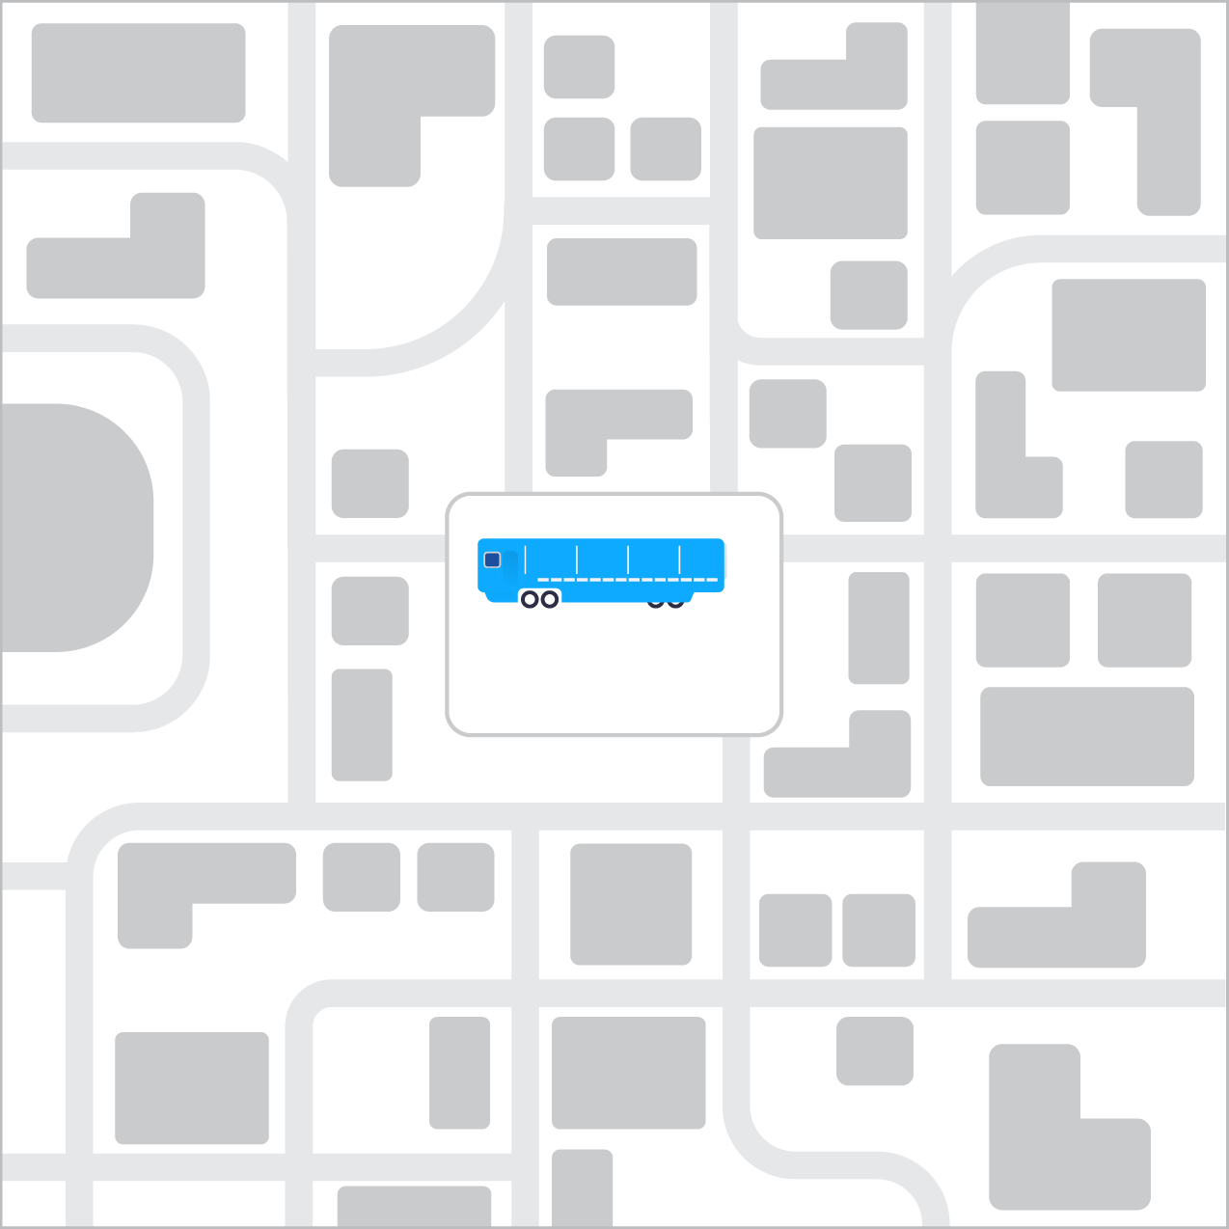
Shield is designed to integrate WITHIN the community – being local is essential
shield | target, test, tell
One of the key challenges to fast turnaround testing is the time it takes to transport samples to the lab.
We solve that problem by integrating a fully equipped and certified mobile lab into your community with the capacity to provide up to 10,000 tests a day.

Slide 43
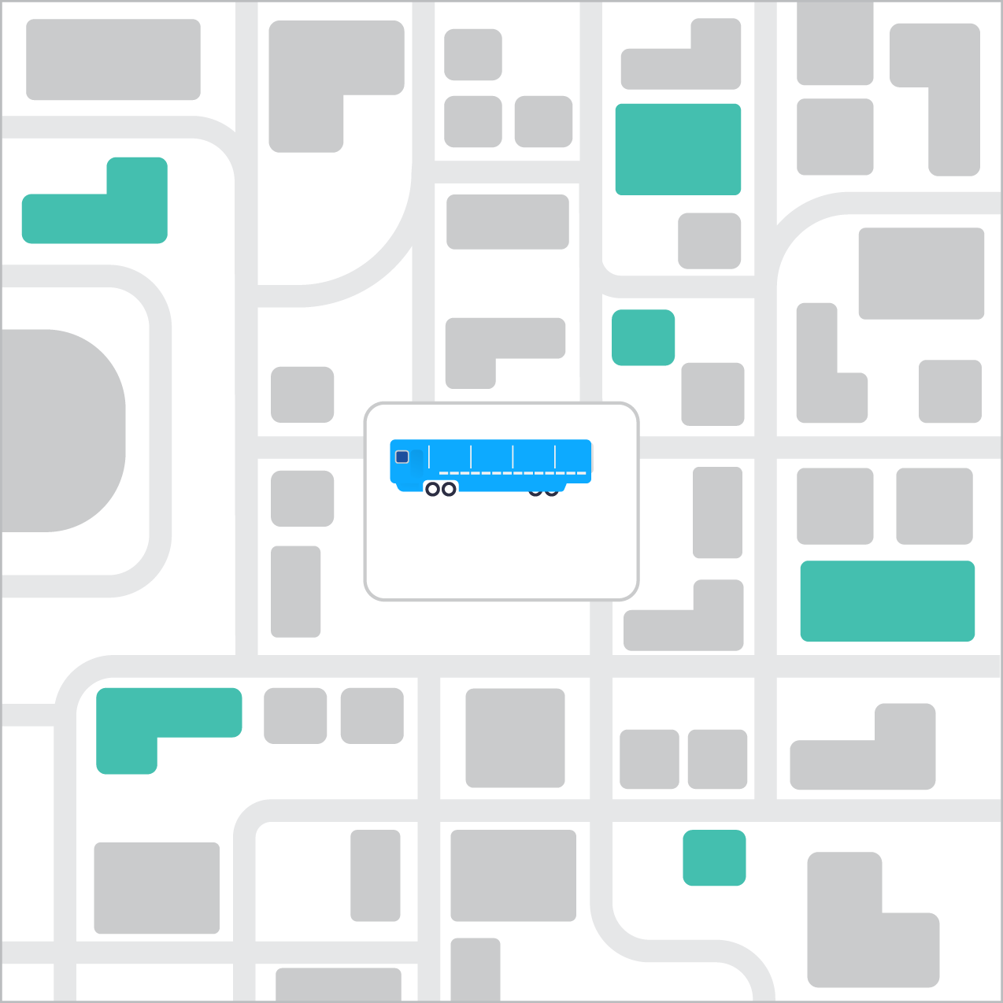
We work WITH YOUR COMMUNITY to meet your testing needs
shield | target, test, tell
The mobile lab is placed on a site that you choose.
Collection sites are set up where participants can give saliva samples under the supervision of trained team members.
Schedule tests and send us a roster to know who’s being tested when.

Slide 44
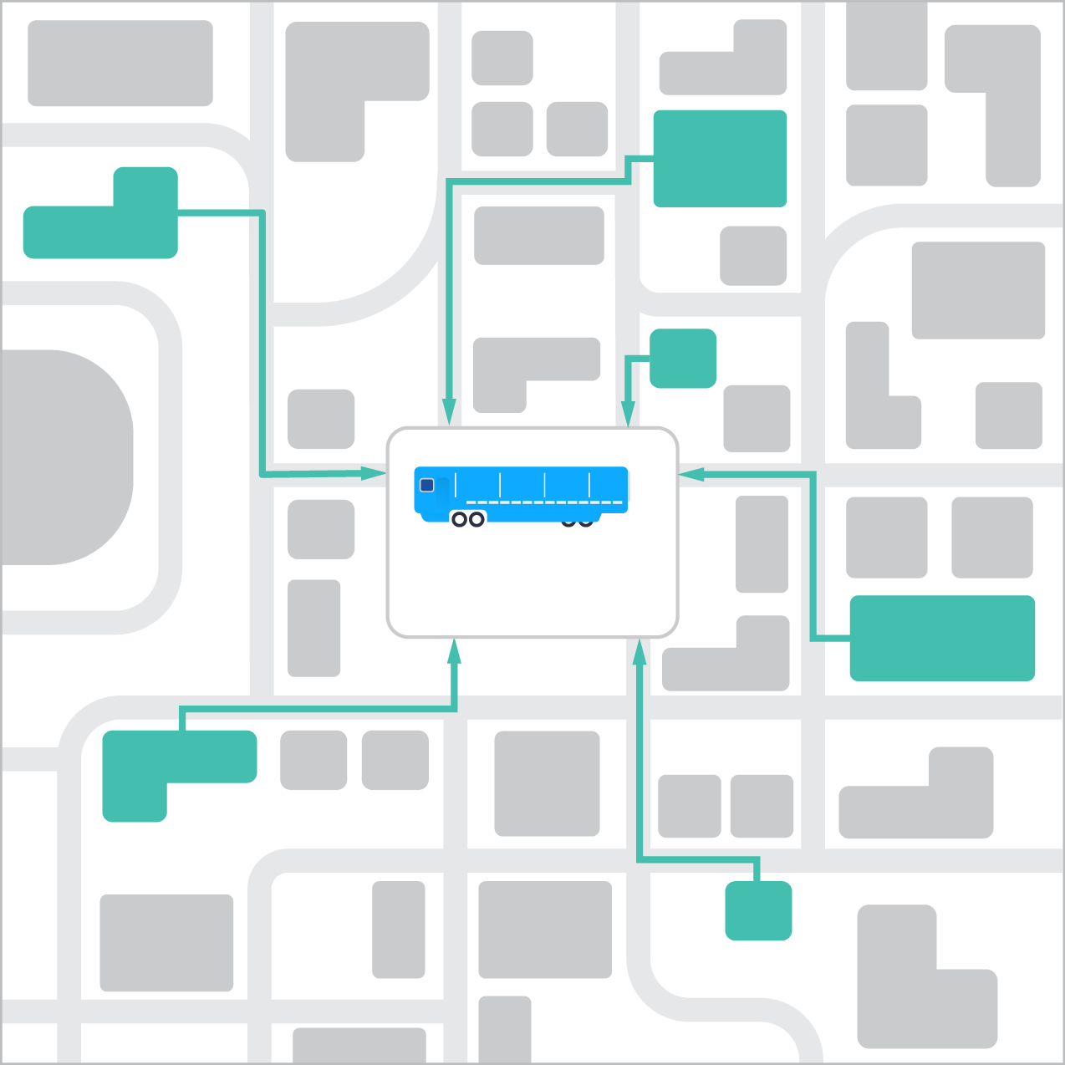
you deliver the samples from the collection sites, we run the tests
shield | target, test, tell
Whether yours is a self-contained community or a consortium of community partners, your final responsibility is to transport collected samples to our mobile lab for testing.
We take it from there.

Slide 45
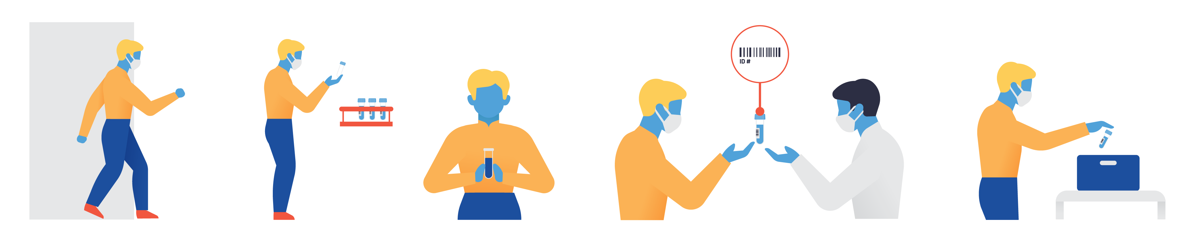
The participant’s COLLECTION experience takes less than three minutes
shield | target, test, tell
1
1
2
3
4
5
Participant arrives at collection site
Participant selects an empty tube
Participant salivates into the tube
Collection site staff scan participant’s ID and vial linking the vial to the participant
Participant places tube in a bag then into a collection bin and departs
Notes:
Beforehand you set the schedule for who gets tested when and send us a roster. On the day of, samples are collected in a monitored setting with plenty of room for social distancing.

Slide 46
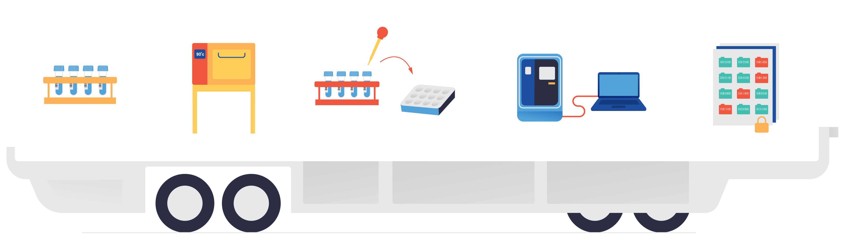
ONCE at THE LAB, samples ARE PROCESSED IN TWO HOURS ON AVERAGE
shield t3 | target, test, tell
1
2
3
4
5
Samples arrive at the lab from collection sites
Samples are heat-deactivated
Samples go through several steps in preparation for testing
Samples are tested for Covid-19 in the PCR test machine
Results are placed in an encrypted database
96 minutes
Notes:
You get the samples to the mobile lab and we take care of the rest. Tests processing from start to end in the lab is an average of two hours, significantly faster than competitors.

